Slide 1
Unit 1: Introduction
WED DEVELOPMENT
3151606

Slide 2
What is Internet?
The Internet is essentially a global network of computing resources. You can think of the Internet as a physical collection of routers and circuits as a set of shared resources.
Some common definitions given in the past include −
A network of networks based on the TCP/IP communications protocol.
A community of people who use and develop those networks.
A community of people who use and develop those networks.

Slide 3
What is WWW?
WWW stands for World Wide Web. A technical definition of the World Wide Web is − All the resources and users on the Internet that are using the Hypertext Transfer Protocol (HTTP).
A broader definition comes from the organization that Web inventor Tim Berners-Lee helped found, the World Wide Web Consortium (W3C): The World Wide Web is the universe of network-accessible information, an embodiment of human knowledge.
In simple terms, The World Wide Web is a way of exchanging information between computers on the Internet, tying them together into a vast collection of interactive multimedia resources.

Slide 4
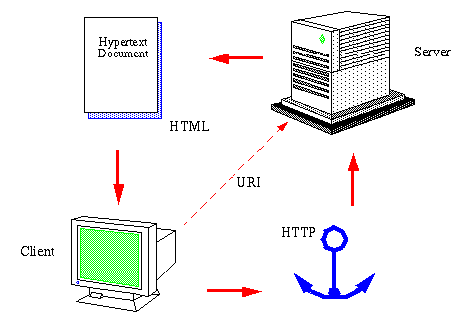

Slide 5
What is HTTP?
HTTP stands for Hypertext Transfer Protocol. This is the protocol being used to transfer hypertext documents that makes the World Wide Web possible.
A standard web address such as Yahoo.com is called a URL and here the prefix http indicates its protocol

Slide 6
What is URL?
URL stands for Uniform Resource Locator, and is used to specify addresses on the World Wide Web. A URL is the fundamental network identification for any resource connected to the web (e.g., hypertext pages, images, and sound files).
A URL will have the following format −
protocol://hostname/other_information

Slide 7
HTTP protocol methods and headers
GET Method
A GET request retrieves data from a web server by specifying parameters in the URL portion of the request. This is the main method used for document retrieval.
HEAD Method
The HEAD method is functionally similar to GET, except that the server replies with a response line and headers, but no entity-body.
POST Method
The POST method is used when you want to send some data to the server, for example, file update, form data, etc.

Slide 8
PUT Method
The PUT method is used to request the server to store the included entity-body at a location specified by the given URL.
DELETE Method
The DELETE method is used to request the server to delete a file at a location specified by the given URL.
CONNECT Method
The CONNECT method is used by the client to establish a network connection to a web server over HTTP.
OPTIONS Method
The OPTIONS method is used by the client to find out the HTTP methods and other options supported by a web server. The client can specify a URL for the OPTIONS method, or an asterisk (*) to refer to the entire server.

Slide 9
HTTP Request and Response
The Hypertext Transfer Protocol (HTTP) is designed to enable communications between clients and servers.
HTTP works as a request-response protocol between a client and server.
Example: A client (browser) sends an HTTP request to the server; then the server returns a response to the client. The response contains status information about the request and may also contain the requested content.
The two most common HTTP methods are: GET and POST.

Slide 10
The GET Method
GET is used to request data from a specified resource.
GET is one of the most common HTTP methods.
Note that the query string (name/value pairs) is sent in the URL of a GET request:
/test/demo_form.php?name1=value1&name2=value2
Some other notes on GET requests:
GET requests can be cached
GET requests remain in the browser history
GET requests can be bookmarked
GET requests should never be used when dealing with sensitive data
GET requests have length restrictions
GET requests are only used to request data (not modify)

Slide 11
The POST Method
POST is used to send data to a server to create/update a resource.
The data sent to the server with POST is stored in the request body of the HTTP request:
POST /test/demo_form.php HTTP/1.1 Host: w3schools.com name1=value1&name2=value2
POST is one of the most common HTTP methods.
Some other notes on POST requests:
POST requests are never cached
POST requests do not remain in the browser history
POST requests cannot be bookmarked
POST requests have no restrictions on data length

Slide 12
 | GET | POST
BACK button/Reload | Harmless | Data will be re-submitted (the browser should alert the user that the data are about to be re-submitted)
Bookmarked | Can be bookmarked | Cannot be bookmarked
Cached | Can be cached | Not cached
Encoding type | application/x-www-form-urlencoded | application/x-www-form-urlencoded or multipart/form-data. Use multipart encoding for binary data
History | Parameters remain in browser history | Parameters are not saved in browser history
Restrictions on data length | Yes, when sending data, the GET method adds the data to the URL; and the length of a URL is limited (maximum URL length is 2048 characters) | No restrictions
Restrictions on data type | Only ASCII characters allowed | No restrictions. Binary data is also allowed
Security | GET is less secure compared to POST because data sent is part of the URL Never use GET when sending passwords or other sensitive information! | POST is a little safer than GET because the parameters are not stored in browser history or in web server logs
Visibility | Data is visible to everyone in the URL | Data is not displayed in the URL

Slide 13
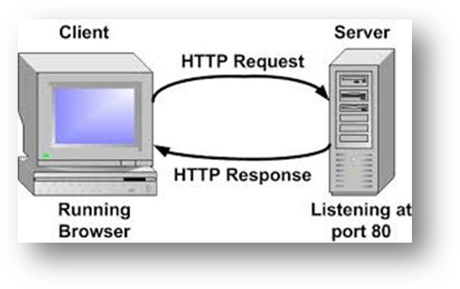

Slide 14
Architecture of web browser
The browser’s consist of the above component where
User Interface is the top bar in the browser, where control lies. It includes space where we type the URL, have back/forward buttons, space where tabs and setting options are.

Slide 15
Browser engine is the bridge between User Interface and the Rendering engine. Based on the inputs from a user it queries and manipulates the rendering engine.
Rendering engine is responsible for parsing HTML/CSS/XML and displaying it into the empty space below User-Interface. Based on the plugins and support it can display other types of media also(like pdf/word).
Networking is fetching resources and handling everything related to the internet.
Javascript interpreter is JS engine which reads and executes the js code and handles the result to the rendering engine.
UI backend is used for drawing basic widgets like combo boxes and windows. This backend exposes a generic interface that is not platform specific. It underneath uses operating system user interface methods.

Slide 16
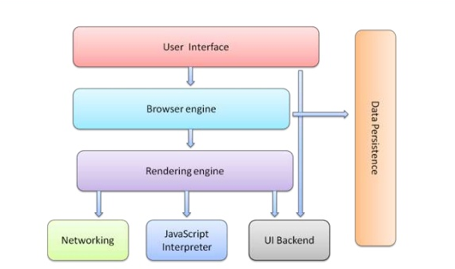
Data Persistence is support for storage mechanisms such as localStorage, IndexedDB, WebSQL, and FileSystem. It is a small database created on the local drive of the computer where the browser is installed. It manages user data such as cache, cookies, bookmarks, and preferences.

Slide 17
Web server installation and configuration
download the files
www.apachelounge.com/download/
extract the files
We will install Apache in C:Apache2, so extract the ZIP file to the root of the C: drive.
configure Apache
Apache is configured with the text file confhttpd.conf contained in the Apache folder. Open it with your favourite text editor.
Line 46, listen to all requests on port 80: Listen *:80
Line 116, enable mod-rewrite by removing the # (optional, but useful): LoadModule rewrite_module modules/mod_rewrite.so
Line 172, specify the server domain name: ServerName localhost:80
Line 224, allow .htaccess overrides: AllowOverride All

Slide 18
change the web page root (optional)
By default, Apache return files found in its htdocs folder. I would recommend using a folder on an another drive or partition to make backups and re-installation easier. For the purposes of this example, we will create a folder called D:WebPages and change httpd.conf accordingly:
Line 179, set the root: DocumentRoot "D:/WebPages“
and line 204: <Directory "D:/WebPages">
test your installation
Your Apache configuration can now be tested. Open a command box (Start > Run > cmd) and enter: cd Apache2bin
httpd –t
Correct any httpd.conf configuration errors and retest until none appear.
install Apache as a Windows service
The easiest way to start Apache is to add it as a Windows service. From a command prompt, enter: cd Apache2bin
httpd -k install

Slide 19
Test the web server
Create a file named index.html in Apache’s web page root (either htdocs or D:WebPages) and add a little HTML code:
<html>
<head><title>testing Apache</title></head>
<body><p>Apache is working!</p></body>
</html>
Ensure Apache has started successfully, open a web browser and enter the address http://localhost/. If all goes well, your test page should appear.

Slide 20
Web security
SSL/TLS
Transport Layer Security (TLS) and its predecessor, Secure Sockets Layer (SSL), are cryptographic protocols designed to provide communications security over a computer network.
SSL (and its successor, TLS) is a protocol that operates directly on top of TCP. This way, protocols on higher layers (such as HTTP) can be left unchanged while still providing a secure connection. Underneath the SSL layer, HTTP is identical to HTTPS.

Slide 21
When using SSL/TLS correctly, all an attacker can see on the cable is which IP and port you are connected to, roughly how much data you are sending, and what encryption and compression is used. He can also terminate the connection, but both sides will know that the connection has been interrupted by a third party.
TLS is based on specifications developed by Netscape Communications’ SSL protocol, which is the predecessor of TLS. TLS and SSL are not interoperable, i.e. TLS cannot be implemented as SSL.

Slide 22
An SSL Connection
Next, we’re going to look into a very basic outline of the process of establishing an SSL connection.
Browser requests a HTTPS webpage
Web Server sends public key and certificate
Browser examines the SSL Certificate
Browser creates a symmetric key and sends it to server
Web server decrypts symmetric key with its private key
Web server sends browser the page with symmetric key
Browser decrypts the data and displays page

Slide 23
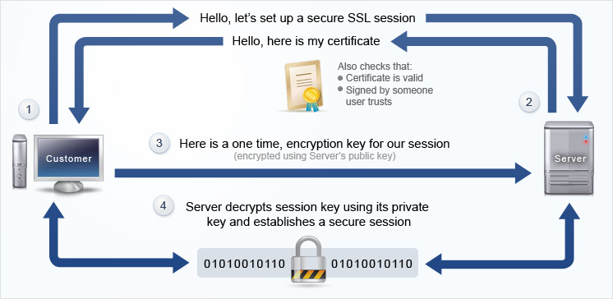

Slide 24
Advantages of Implementing HTTPS
Trust – If you get an EV certificate that shows the green address bar in the browser, you’re going to be giving your visitors a sense of trust. And when they know you’re taking their security seriously, they’re going to be appreciative.
Verification – One of the best things about installing an SSL certificate on your server is that it guarantees your visitors you really are who you say you are. This is important when trying to do business online.
Integrity of Data – Additionally, with SSL, you can guarantee integrity of data. For example, without SSL, it’s possible to not only intercept data going to and from the web server, but to change it as well!
Google and SEO – Last but not least, you have to take into consideration the recent announcements by Google that they’re going to be using whether or not a server uses SSL as a ranking signal.

Slide 25
Disadvantages of SSL
Cost of Certificate – It is possible to get a free SSL certificate, but this isn’t recommended for a lot of reasons. Depending on the type of cert you buy, the price will vary quite a bit. However, when you consider the added level of security, the cost isn’t really prohibitive for most websites.
Mixed Modes – If your SSL implementation isn’t setup correctly and you still have some files being served via HTTP rather than HTTPS, visitors are going to get a warning message in their browser letting them know some of the data isn’t protected. This can be confusing to some website visitors.
Proxy Caching – Another possible problem is if you have a complex proxy caching system setup on your web server. Encrypted content isn’t going to be able to be cached. To get around this, you need to add a server to handle the encryption before it gets to the caching server. This will require additional costs, but it’s a good way to make sure you’re encrypting your visitors’ data when they’re accessing your website.
Mobile – When SSL was first implemented, it was meant for web based applications. While the ability to go beyond HTTPS has come a long way in the last few years, it can sometimes be a pain to setup and might require changes to in-house software or buying additional modules from application vendors. Still, for everything that is on the web or accessible via a web browser, SSL / TLS is definitely the way to go.

Slide 26
CORS (Cross-Origin Resource Sharing)
CORS, is an HTML5 feature that allows one site to access another site’s resources despite being under different domain names. Let me explain that a little more. Prior to CORS, a web browser security restriction, known as the Same-Origin Policy, would prevent my web application from calling an external API. The browser would consider two resources to be of the same-origin only if they used the same protocol (http vs. https), the same port, and the same domain (even different subdomains would fail).

Slide 27
With CORS, my web app on one domain can freely communicate with your API on another domain, even using the methods POST, PUT, and DELETE, provided that your API’s security restrictions specify that this is allowed and that you have established the communication through the CORS specification as well. This means that you can eliminate the need for a server-side component and do all the API communication on the client-side using JavaScript.

Slide 28
Cross-site Scripting attack
Cross-site Scripting (XSS) refers to client-side code injection attack wherein an attacker can execute malicious scripts (also commonly referred to as a malicious payload) into a legitimate website or web application. XSS is amongst the most rampant of web application vulnerabilities and occurs when a web application makes use of unvalidated or unencoded user input within the output it generates.
By leveraging XSS, an attacker does not target a victim directly. Instead, an attacker would exploit a vulnerability within a website or web application that the victim would visit, essentially using the vulnerable website as a vehicle to deliver a malicious script to the victim’s browser.

Slide 29
Understanding SEO
Search Engine Optimization (SEO) is the activity of optimizing web pages or whole sites in order to make them search engine friendly, thus getting higher positions in search results.
SEO stands for Search Engine Optimization. SEO is all about optimizing a website for search engines. SEO is a technique for:
designing and developing a website to rank well in search engine results.
improving the volume and quality of traffic to a website from search engines.
marketing by understanding how search algorithms work, and what human visitors might search.

Slide 30
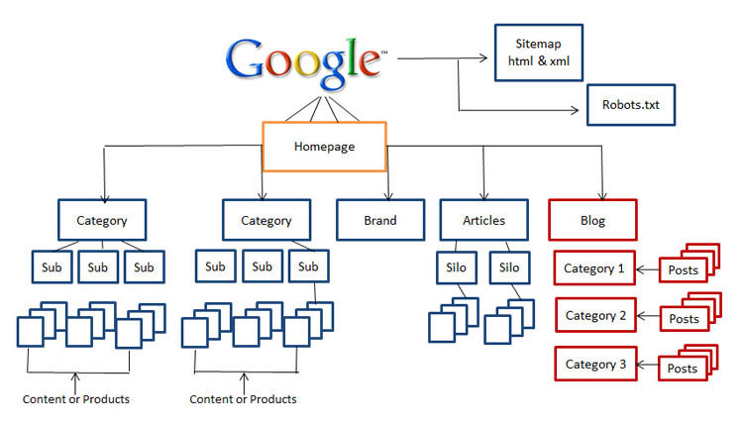

Slide 31
How Search Engine Works?
Search engines perform several activities in order to deliver search results.
Crawling - Process of fetching all the web pages linked to a website. This task is performed by a software, called a crawler or a spider (or Googlebot, in case of Google).
Indexing - Process of creating index for all the fetched web pages and keeping them into a giant database from where it can later be retrieved. Essentially, the process of indexing is identifying the words and expressions that best describe the page and assigning the page to particular keywords.
Processing - When a search request comes, the search engine processes it, i.e. it compares the search string in the search request with the indexed pages in the database.

Slide 32
Calculating Relevancy - It is likely that more than one page contains the search string, so the search engine starts calculating the relevancy of each of the pages in its index to the search string.
Retrieving Results - The last step in search engine activities is retrieving the best matched results. Basically, it is nothing more than simply displaying them in the browser.
Search engines such as Google and Yahoo! often update their relevancy algorithm dozens of times per month. When you see changes in your rankings it is due to an algorithmic shift or something else outside of your control.

Slide 33
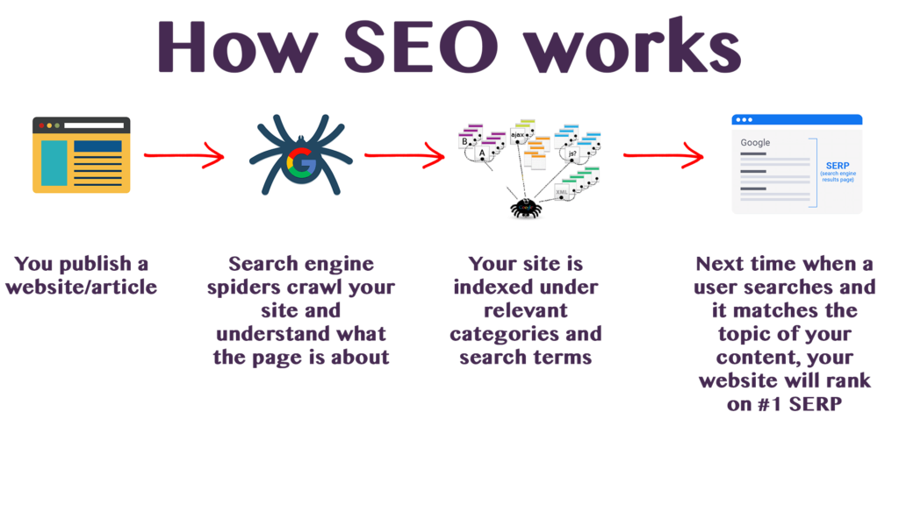

Slide 34
What is SEO Copywriting?
SEO Copywriting is the technique of writing viewable text on a web page in such a way that it reads well for the surfer, and also targets specific search terms. Its purpose is to rank highly in the search engines for the targeted search terms.
Along with viewable text, SEO copywriting usually optimizes other on-page elements for the targeted search terms. These include the Title, Description, Keywords tags, headings, and alternative text.
The idea behind SEO copywriting is that search engines want genuine content pages and not additional pages often called "doorway pages" that are created for the sole purpose of achieving high rankings.

Slide 35
What is Search Engine Rank?
When you search any keyword using a search engine, it displays thousands of results found in its database. A page ranking is measured by the position of web pages displayed in the search engine results. If a search engine is putting your web page on the first position, then your web page rank will be number 1 and it will be assumed as the page with the highest rank.
SEO is the process of designing and developing a website to attain a high rank in search engine results.

Slide 36
What is On-Page and Off-page SEO?
Conceptually, there are two ways of optimization:
On-Page SEO - It includes providing good content, good keywords selection, putting keywords on correct places, giving appropriate title to every page, etc.
Off-Page SEO - It includes link building, increasing link popularity by submitting open directories, search engines, link exchange, etc.

Slide 37
